Slide 1
Fitness Tracker App
Jack Snyder & Trevor Lough

Slide 2
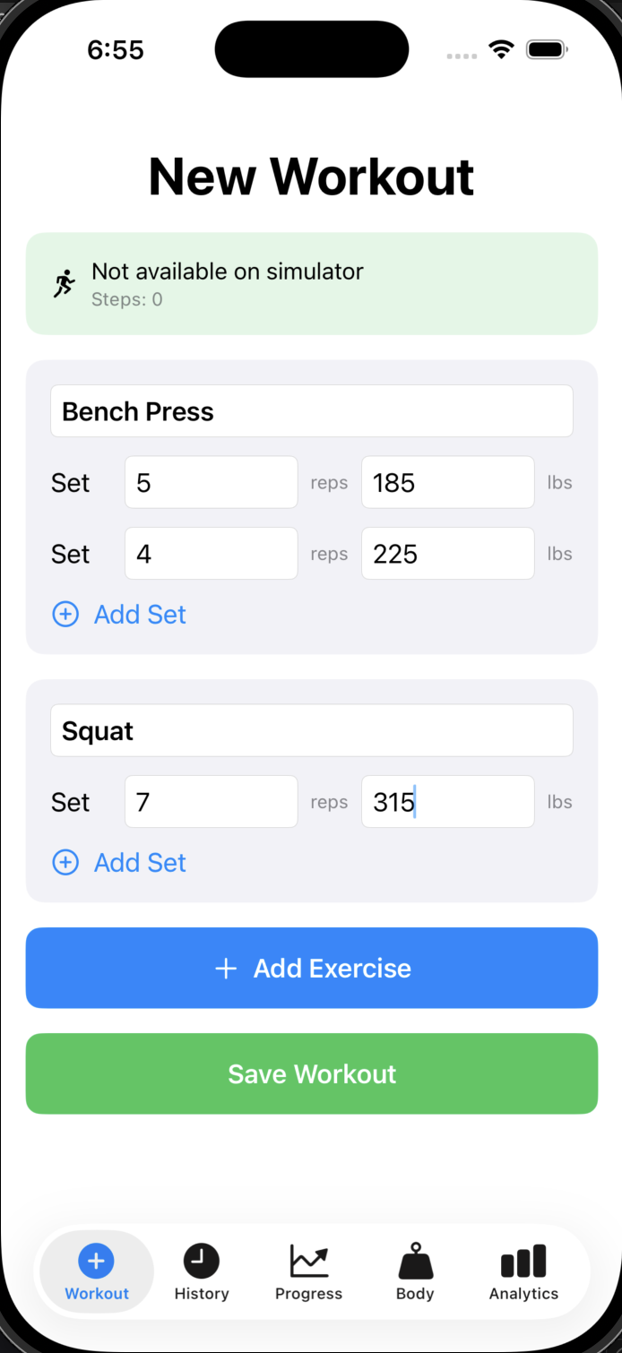
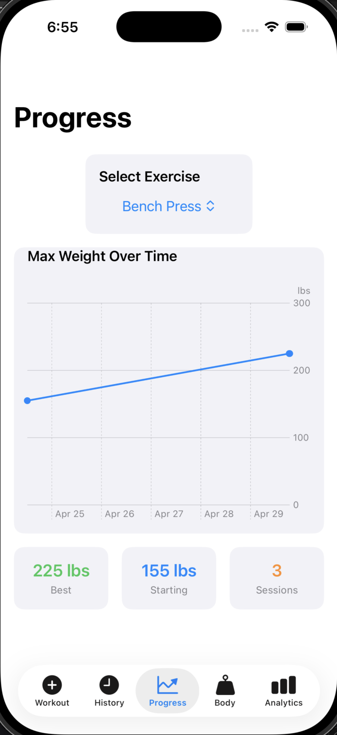
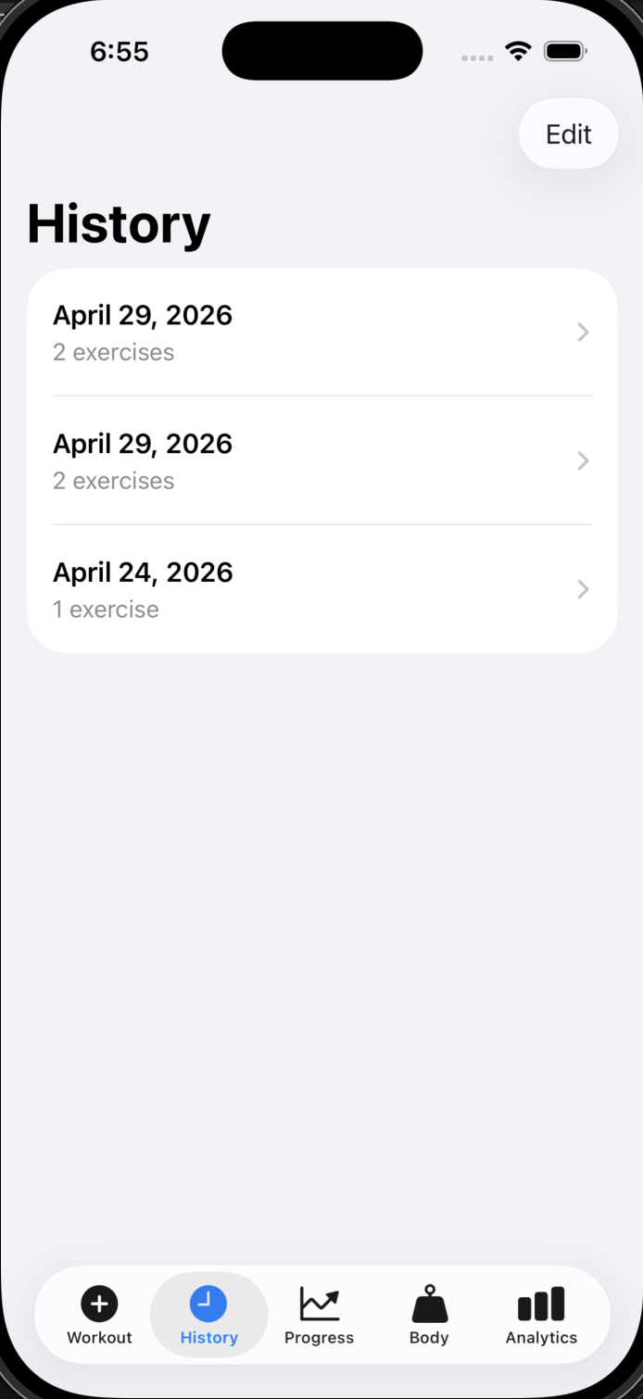
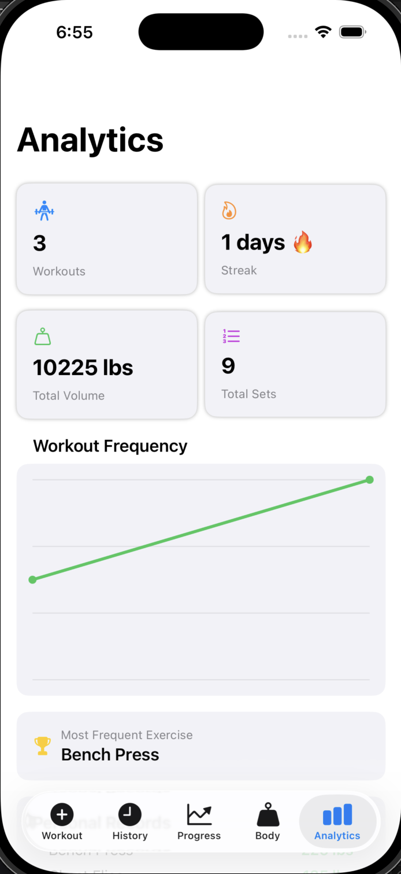
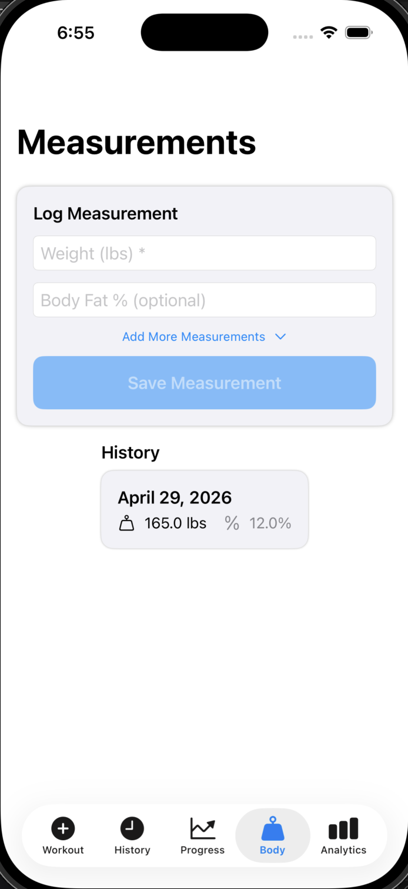
Views
Our Fitness Tracker app has 5 main views, embedded in a tab view, and these are:
Workout View (to add workouts to your log)
History View (to see, edit, and delete your workouts log)
Progess View (to track progress by exercise)
Measurement View (to track your body measurements progress: weight, BF%, etc)
Analytics View (insight into your overall fitness performance and stats)
[Built with SwiftUI]

Slide 3
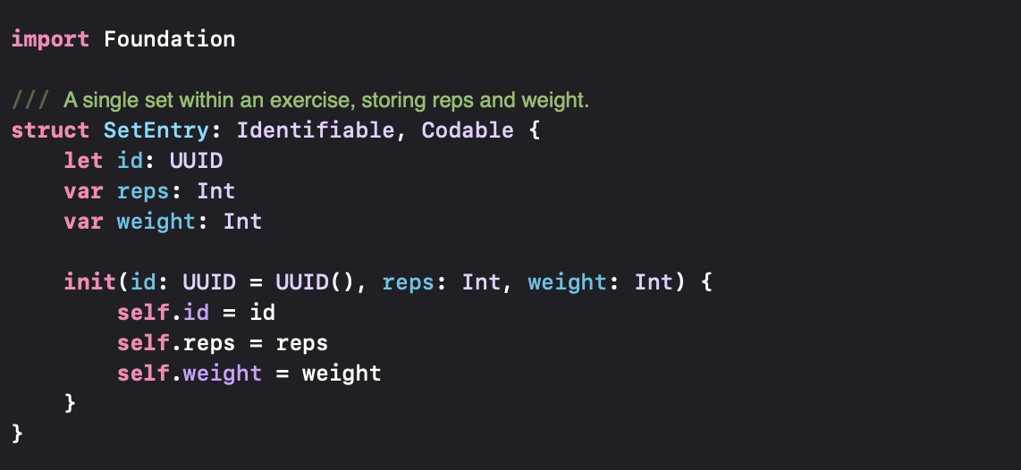
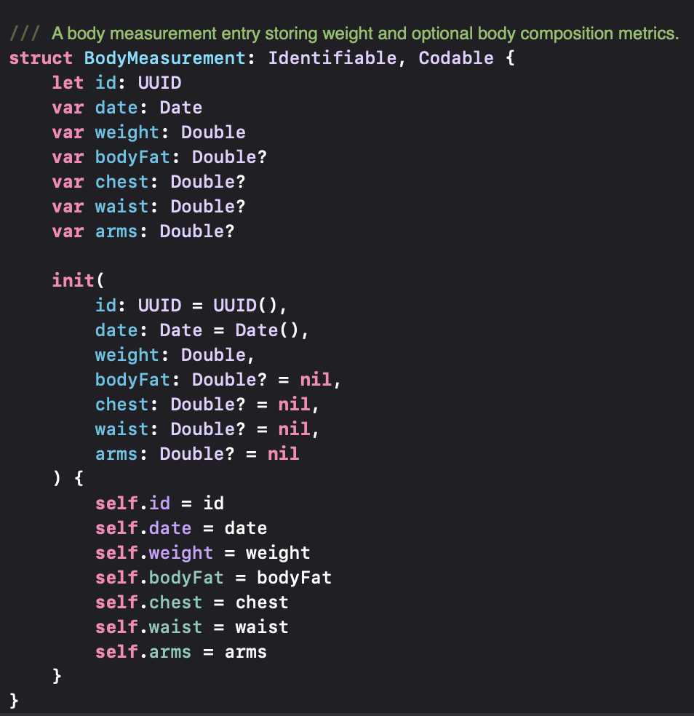
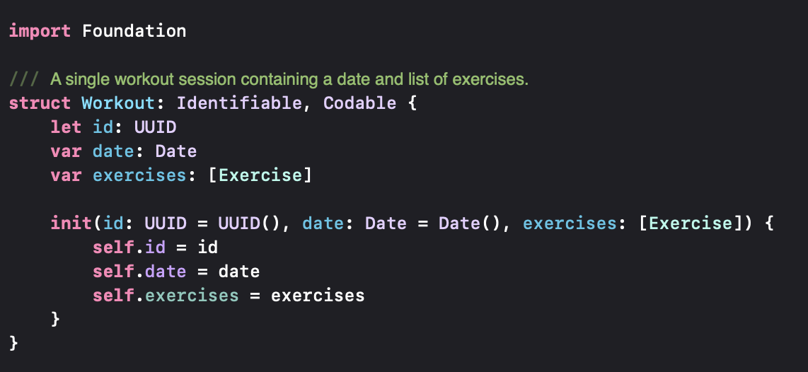
Models
Our main model objects are Workout, which includes one or multiple Exercises, which includes multiple SetEntry’s, and finally an independent BodyMeasurement object.

Slide 4
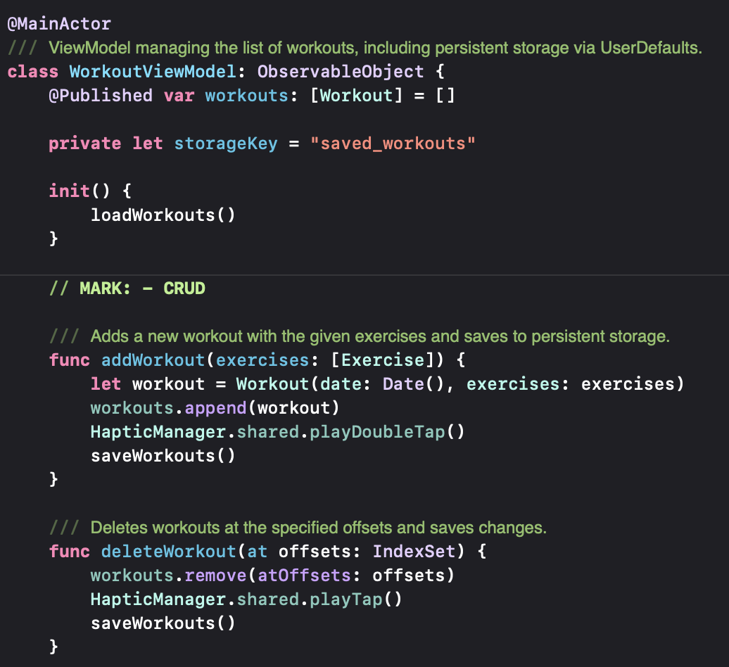
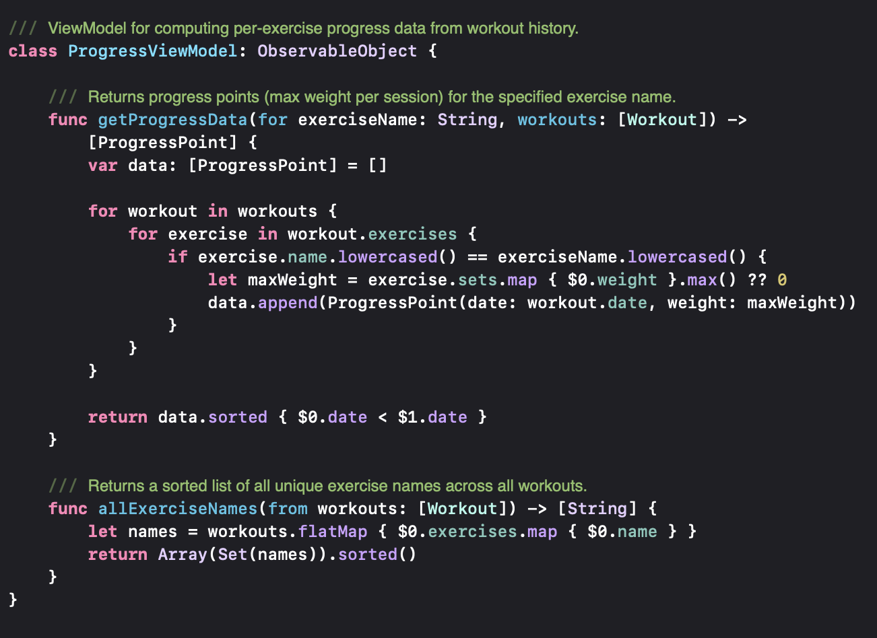
ViewModels (Controllers)

Slide 5
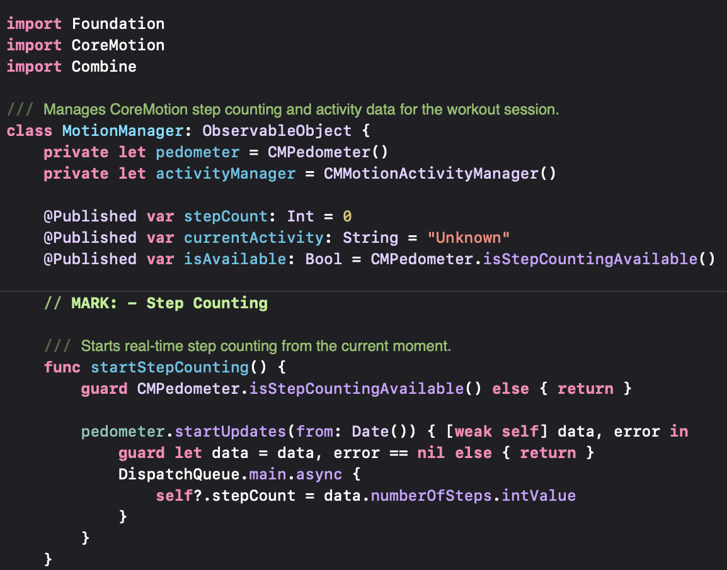
Additional Features
Core Motion
Records current steps taken and records it in the ‘New Workout’ window of the WorkoutView.

Slide 6
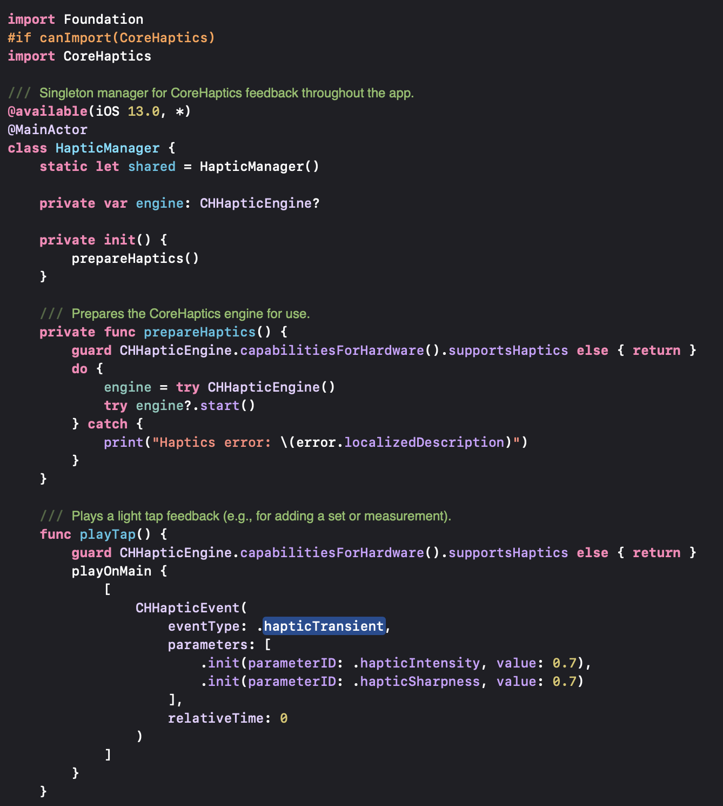
Core Haptics
Gives vibrational feedback when certain actions are performed, like saving a workout or adding an exercise.

Slide 7
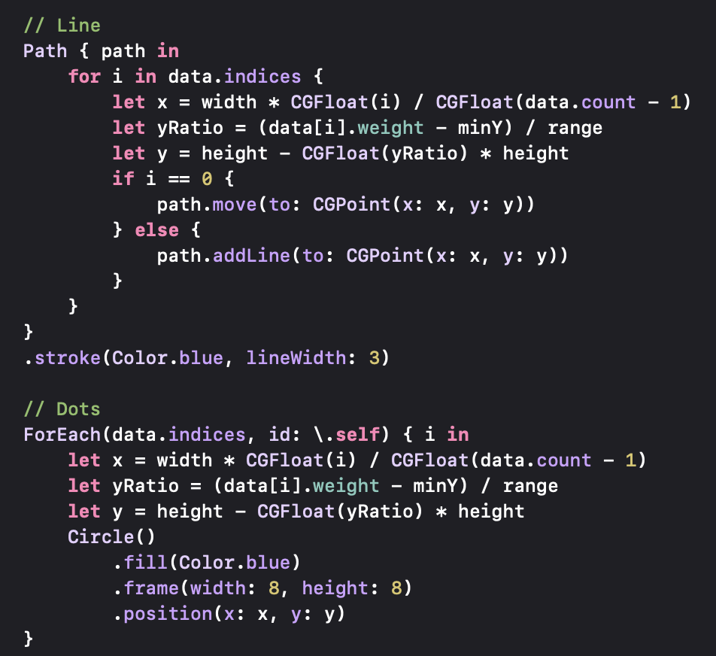
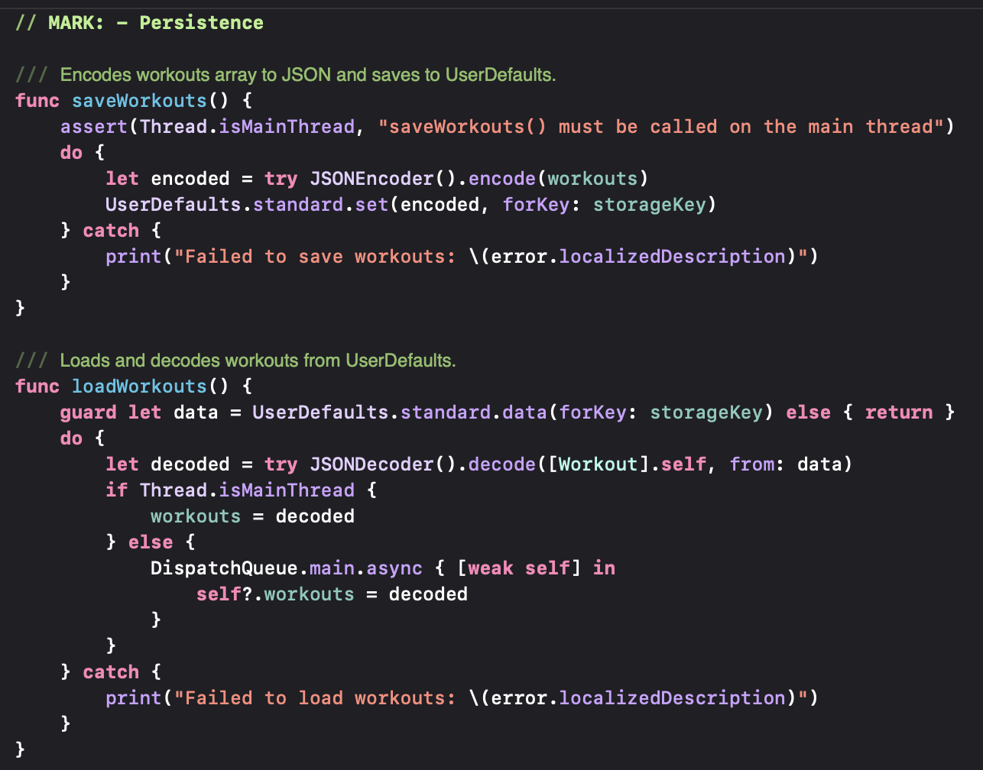
CoreGraphics/Charts & Persistent Storage

